Slide 1
Replication – DDIA Chapter 5
Notes:
Welcome everyone! For the next thirty minutes we are going to unpack Chapter 5 of Martin Kleppmann’s Designing Data‑Intensive Applications — the chapter that lays the foundation for everything that follows in the book by explaining *replication*. Replication simply means keeping the same data on multiple machines, yet the devil is in the details: the moment you have more than one copy you must worry about how changes are propagated, what happens when machines or networks fail, and which trade‑offs you are willing to make between consistency, availability, latency, and throughput.
By the end of the talk you should be able to: ① explain *why* systems replicate data, ② walk through the three major replication families — single‑leader, multi‑leader, and leaderless — ③ recognise the classic anomalies that appear when replicas lag behind, and ④ read the diagrams in the chapter and relate them to real systems such as Postgres, MySQL, Cassandra, and Riak.
Grab a seat, open your mental notebook, and let’s get started.

Slide 2
Key Concepts – What & Why
Replication = copying the same dataset to multiple nodes that communicate over a network
Primary goals:
Lower latency by putting data closer to users
Raise availability by surviving failures
Scale reads by load‑balancing queries
Secondary goal: Disconnected operation (e.g. mobile, field devices)
BUT: Copies must cope with faults & concurrency → trade‑offs
Notes:
Before we jump into algorithms we need a common vocabulary.
*Replication* is nothing more than copying an identical dataset to several machines connected by a network. We do it for four main reasons.
First, **latency**: if your users are in Sydney you do not want every request to cross the Pacific to Virginia. A nearby replica means a faster round‑trip.
Second, **availability**: when hardware, software, or an entire data‑centre dies the system keeps serving traffic because some other replica can take over.
Third, **read scalability**: web workloads are often ninety‑plus‑percent reads; by adding read‑only copies you scale horizontally without sharding.
Finally, **disconnected or offline operation**: your calendar still works on an aeroplane because the phone keeps a replica and merges later.
Those benefits are powerful, but they come with headaches: how do you ensure that changes are delivered, in the right order, in the presence of crashes, slow networks, or two people writing the same record at once? The rest of this talk is dedicated to those headaches — and their cures.

Slide 3
Key Concepts – Types of Guarantees
Durability – once an ack is returned the data should not disappear
Consistency model – what a client is allowed to observe when replicas lag (strong, eventual, read‑after‑write, etc.)
Failover – automatic vs manual promotion when a replica dies
Synchronous vs Asynchronous replication – blocking vs non‑blocking write path
Notes:
The second lens for thinking about replication is the *kind* of guarantee we promise to applications.
• **Durability** answers the question: “if I get HTTP 200, will my write still exist after the leader explodes?”
• **Consistency models** describe what a reader may observe when there is lag. At one end is *linearizability* — every read sees the very latest write; in the middle sit practical constraints such as *read‑after‑write* or *monotonic reads*; and at the far end is *eventual consistency* where replicas converge some time after the fact.
• **Failover** policy covers how the system chooses a new leader when the old one is gone, how it avoids the dreaded *split‑brain*, and what it does with any writes that were in‑flight.
• Finally, **synchronous versus asynchronous** is the classic tension: block the client until the write is safely on multiple nodes to maximise safety, or return early and pick up the pieces later to keep latency low.
Keep these four axes in mind — every algorithm we see will be a point in this design space.

Slide 4
Single‑Leader Replication – Architecture
One replica is elected leader / primary
All writes flow through the leader → ordered log
Followers (read replicas) stream change‑log and apply in same order
Clients may read from leader or followers (with caveats)
Notes:
Let’s start with the architecture most of us already use, often without thinking about it: **single‑leader replication**.
The diagram on *page 3* of the chapter — now reproduced on the right — shows a write query arriving at the leader. The leader executes the statement, appends it to its replication log, and immediately returns the result to the client. Concurrently, it ships that same log entry to each follower, which replays the change in the identical sequence.
Because there is exactly one write point, we get a total order of updates ‘for free’, which eliminates conflicts. Read traffic, on the other hand, is flexible: latency‑sensitive reads can hit a nearby follower while strongly‑consistent reads may go to the primary.
Real systems: Postgres streaming replication, MySQL replica‑sets, MongoDB replica‑sets, Kafka partitions, and even block‑device mirroring like DRBD all follow this pattern.
Keep an eye on the arrows in the figure — every complexity we explore later boils down to how fast those arrows are allowed to move and what happens when they break.

Slide 5
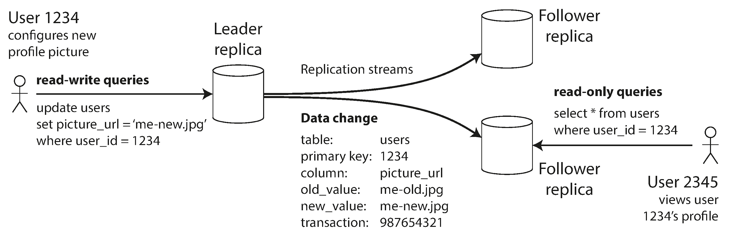
Single‑Leader Replication – Architecture
Notes:
Let’s start with the simplest architecture: single-leader replication.
This diagram from page 3 of the chapter shows a write query arriving at the leader. The leader executes the statement, appends it to its replication log, and immediately returns the result to the client. Concurrently, it ships that same log entry to each follower, which replays the change in the identical sequence.
Because there is exactly one write point, we get a total order of updates ‘for free’, which eliminates conflicts.
Read traffic, on the other hand, is flexible: latency-sensitive reads can hit a nearby follower while strongly-consistent reads may go to the primary.
Real systems: Postgres streaming replication, MySQL replica-sets, MongoDB replica-sets, Kafka partitions, and even block-device mirroring like DRBD all follow this pattern.
Keep an eye on the arrows in the figure — every complexity we explore later boils down to how fast those arrows are allowed to move and what happens when they break.

Slide 6
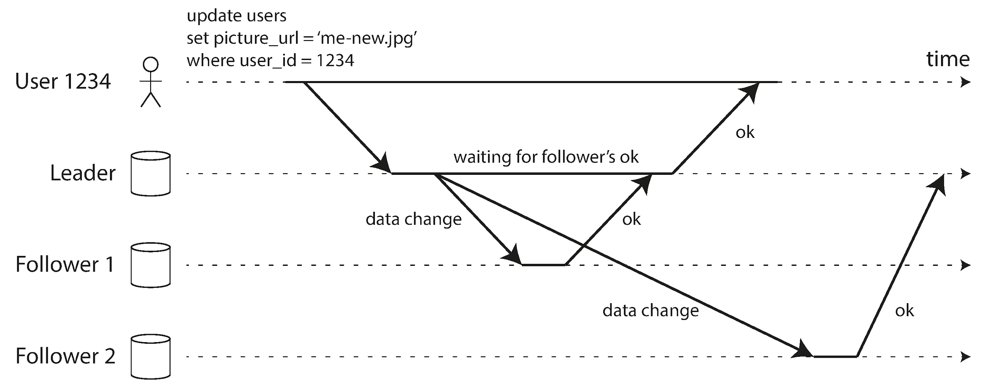
Sync vs Async Replication
Notes:
Figure 5-2 from page 4 visualises the timing difference. The dark arrows are network round-trips: • In the synchronous stream (upper path) the leader blocks at the ‘waiting for follower’s OK’ step. Only once the replica durable-writes does the client hear ‘success’. If the primary crashes right after returning, we still have at least one complete copy. • In the asynchronous stream (lower path) the leader fire-and-forgets the log entry. The client is satisfied, latency is great, but for a brief—or sometimes very long—window the data lives on exactly one machine. If that machine dies, the write evaporates.
Most production deployments choose a hybrid: one synchronous replica for durability, the rest asynchronous for throughput. That strategy is often called semi-synchronous replication.\
Full synchronous isn't practical because a signal follower crash will block all writes.
When you design a system ask yourself: what is the business value of shaving, say, 10 ms off the P99 latency, versus the cost of possibly losing a user’s purchase? The answer differs between a social network ‘like’ and a bank transfer.

Slide 7
Sync vs Async Replication
Synchronous: leader waits for ≥1 follower ack before committing
Guarantee: replica is up‑to‑date → no data loss on leader crash
Cost: higher latency, system stalls if sync replica is slow/unreachable
Asynchronous: leader returns immediately
Advantage: low latency, survives follower outages; Risk: lost writes

Slide 8
Follower Setup & Recovery
Create consistent snapshot of leader without long downtime
Ship snapshot to new node, then catch‑up via replication log
Follower failure ⇒ replay log from last processed LSN / binlog pos
Leader failure ⇒ failover: elect new leader, re‑point clients, discard or reconcile unreplicated writes
Notes:
Keeping followers healthy requires an operations team. You
Initial provisioning starts with a consistent snapshot — Postgres’ pg_basebackup, MySQL’s innobackupex, or storage-level snapshots all serve.
The important trick is tagging the snapshot with the exact position in the replication log, sometimes called the LSN or binlog coordinate.
Once the copy is online, the follower streams the backlog of changes until it is caught up. All this bookeeping is done for you if you use managed services like AWS RDS / Auorora or Google Cloud SQL.
If a follower later crashes, it does not require a fresh snapshot. It looks at the last transaction it fsynced, reconnects to the leader, and asks for “everything after X.”
Leader failure is harder. A failover controller — human or automated — must detect the outage, pick the most-up-to-date follower, and promote it.
Any writes that were only on the dead node are gone unless replication was synchronous.
The controller must then reconfigure every other replica to follow the new primary and ensure the old primary never comes back believing it is still boss, otherwise you get the dreaded split-brain.
These operational realities, more than pure performance, often dictate which replication flavour a team is comfortable running.

Slide 9
Implementation Techniques
Statement‑based – ship original SQL; brittle with nondeterminism
Write‑Ahead Log (WAL) shipping – physical block changes; tight coupling to storage engine version
Logical / Row‑based logs – per‑row ‘before/after’; decoupled from storage, great for CDC
Trigger‑based – application‑level hooks when built‑ins fall short
Notes:
Under the hood, the ‘stream of changes’ can take many shapes:
*Statement‑based replication* literally replays the SQL text. It is compact but unsafe when the statement includes nondeterministic functions like `NOW()` or `RAND()`, or when two transactions interleave differently on followers.
*WAL shipping* copies the physical bytes that changed on disk — imagine rsyncing modified 8‑KB blocks. That captures an exact binary image but couples replicas to the leader’s storage engine internals. A major‑version upgrade that tweaks on‑disk format usually mandates downtime because old and new nodes cannot understand each other’s WAL.
*Logical logs* — MySQL’s row‑based binlog, Postgres logical decoding, Debezium — describe changes at the row level: “DELETE where id=7” or “new record with these column values.” Because the format is independent of physical layout, you can upgrade followers first, perform failover, and then upgrade the old leader with zero downtime. Logical logs also power Change‑Data‑Capture pipelines—think Kafka Connect streaming MySQL tables into analytics.
Finally, when the built‑ins are insufficient, you can move replication into **triggers** or stored procedures. Tools like Oracle GoldenGate or Bucardo for Postgres log changes to ad‑hoc tables that an external agent consumes. More flexible, yes, but also more moving pieces and edge‑cases.

Slide 10
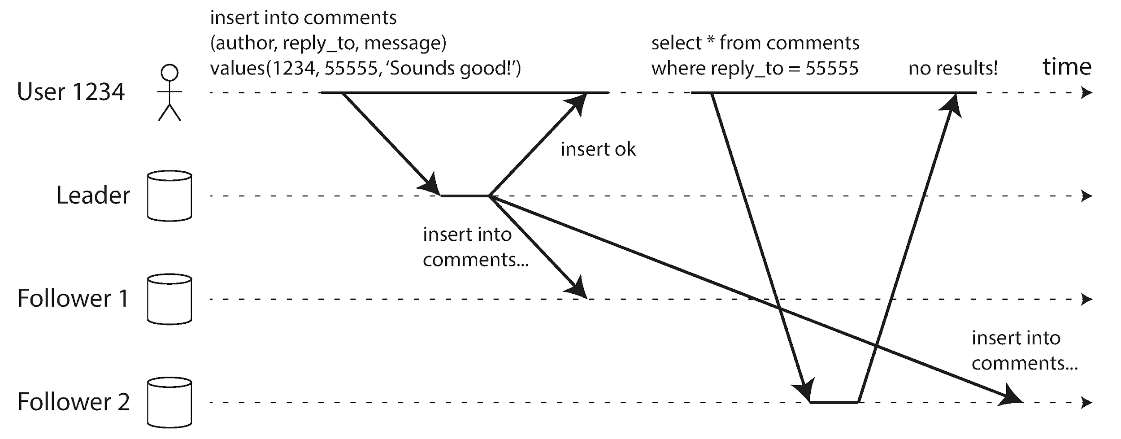
Replication Lag & Anomalies
Notes:
Even when everything is healthy, asynchronous followers trail the leader by a non-zero delay. Under normal load that delay is milliseconds, but if a replica is replaying a large backlog or if the network hiccups, the delay can stretch into minutes.
Figure 5-3 from page 13 shows the classic read-after-write anomaly: a user submits an update that goes to the leader, immediately refreshes the page, but the load-balancer routes the GET to a lagging follower which hasn’t seen the change yet. The user thinks their edit was lost. This can happen if you upload your FB profile picture
From there we get two more anomalies: * Monotonic reads: a session should never move backwards in time — seeing a post, then suddenly not seeing it as in Figure 5-4. * Consistent prefix: causally-related writes must be observed in the same order everywhere, otherwise — as in Figure 5-5 — Mrs Cake answers Mr Poons before he asks his question.
Avoiding surprises means either making selective reads to the primary, using per-user stickiness, incorporating logical timestamps, or designing your UX to tolerate eventual consistency.

Slide 11
Replication Lag & Anomalies
Replication lag ≠ bug — it’s inherent to async pipelines
Key anomalies:
Read‑after‑write violation
Monotonic read violation
Consistent‑prefix violation
Lag can spike from <1 s to minutes under load or recovery
Solution space: targeted reads to leader, session stickiness, timestamps

Slide 12
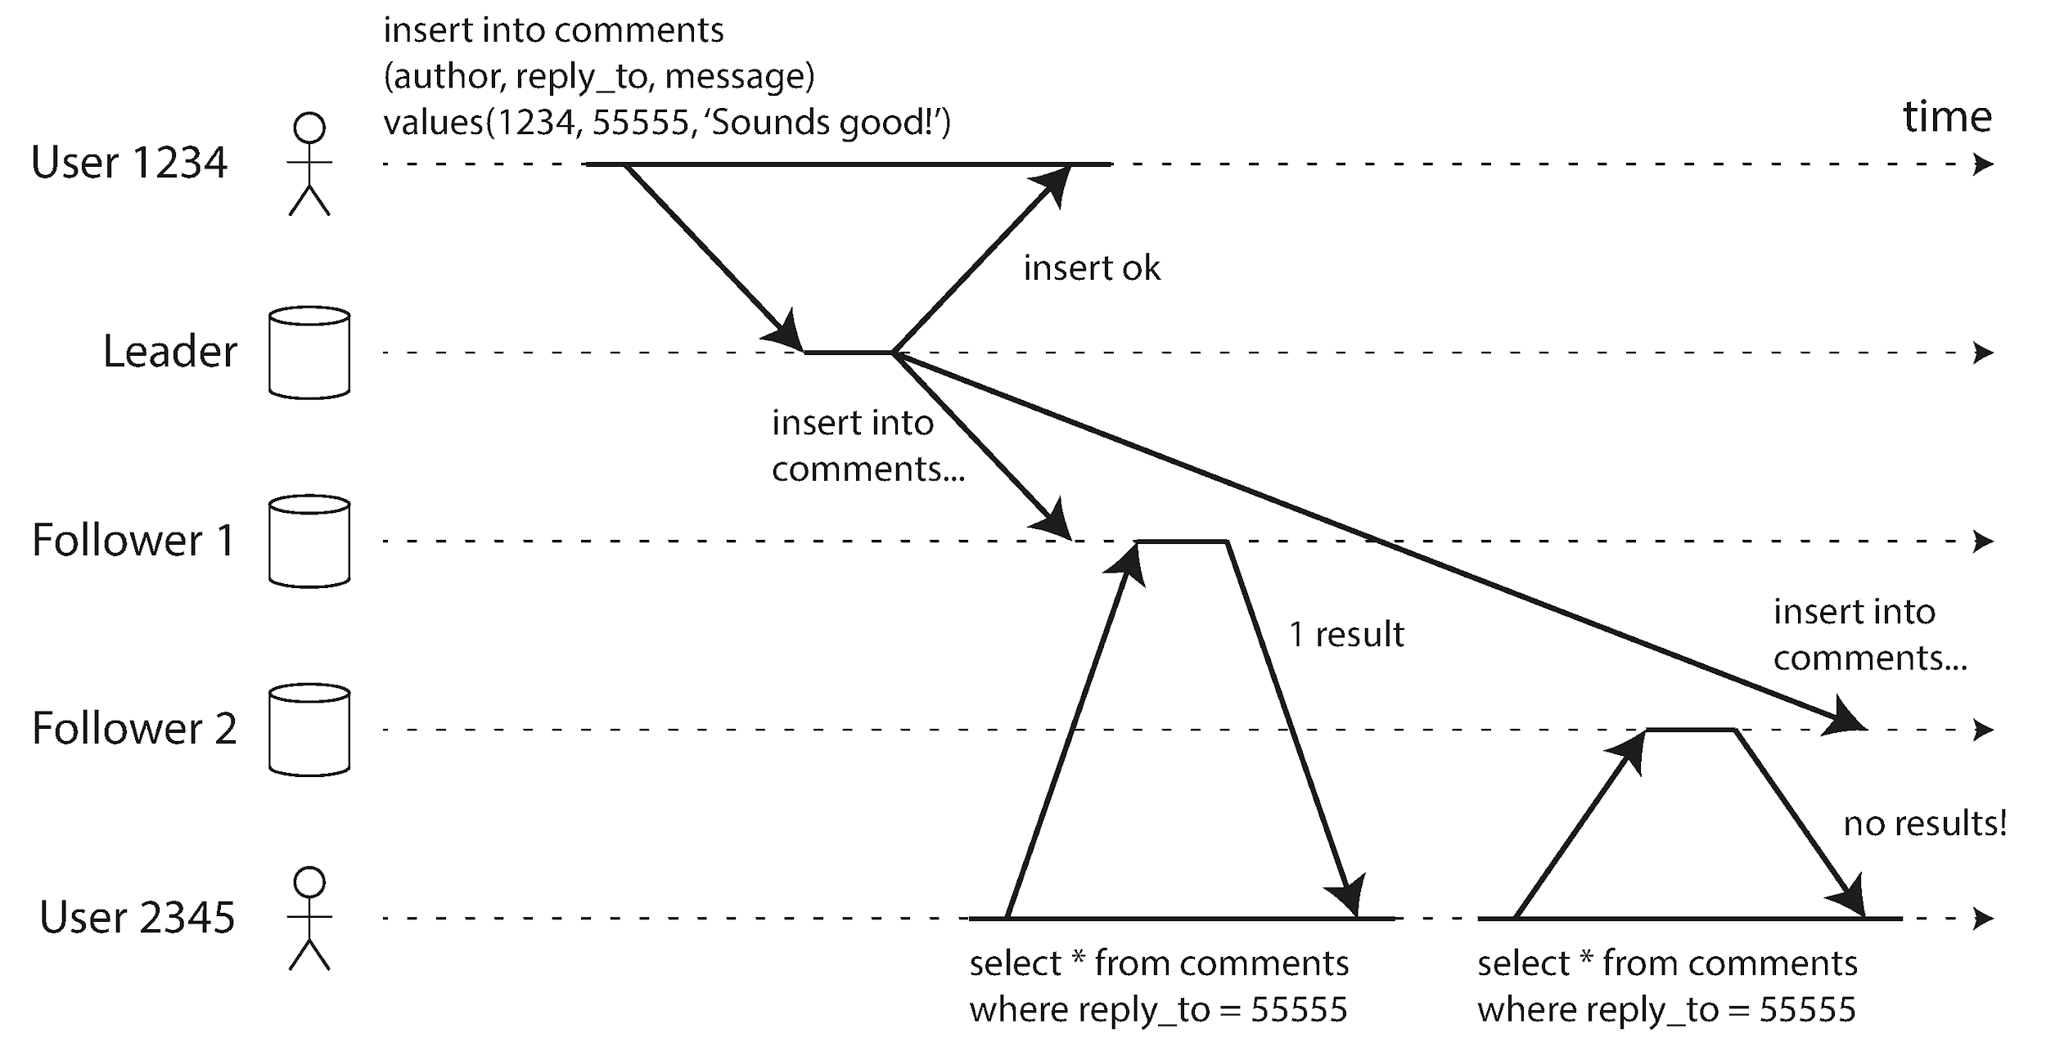
Read‑After‑Write & Monotonic Reads
Notes:
In eventual consistency, we often add session guarantees.
Read-after-write (RYW) gives users confidence that “the system saved my change.” You can implement it by marking the session “dirty” for, say, sixty seconds and routing all reads to the leader during that window; or, more elegantly, by attaching the log sequence number of the write to the client and only permitting reads from replicas whose replay position is ≥ that LSN.
Monotonic reads go one step further: you must never show the user older data than what they have already seen. The easy trick is to sticky-hash the user to a single replica. If that node dies you lose the guarantee unless you teach the clients to remember the highest-seen timestamp and include it in their requests.
Both guarantees are routinely asked for by product teams yet often overlooked until the first “why did my post disappear?” ticket lands in your inbox. They are also stepping stones toward stronger transactional semantics we revisit in Chapter 7.

Slide 13
Read‑After‑Write & Monotonic Reads
Practical guarantees stronger than eventual consistency
Read‑after‑write: a user must immediately see their own update
Implementations:
route session reads to leader
hold‑off reads until follower ≤ lag threshold
attach logical timestamp and reject stale replicas
Monotonic reads: once a user sees X they will never see ‘not‑X’

Slide 14
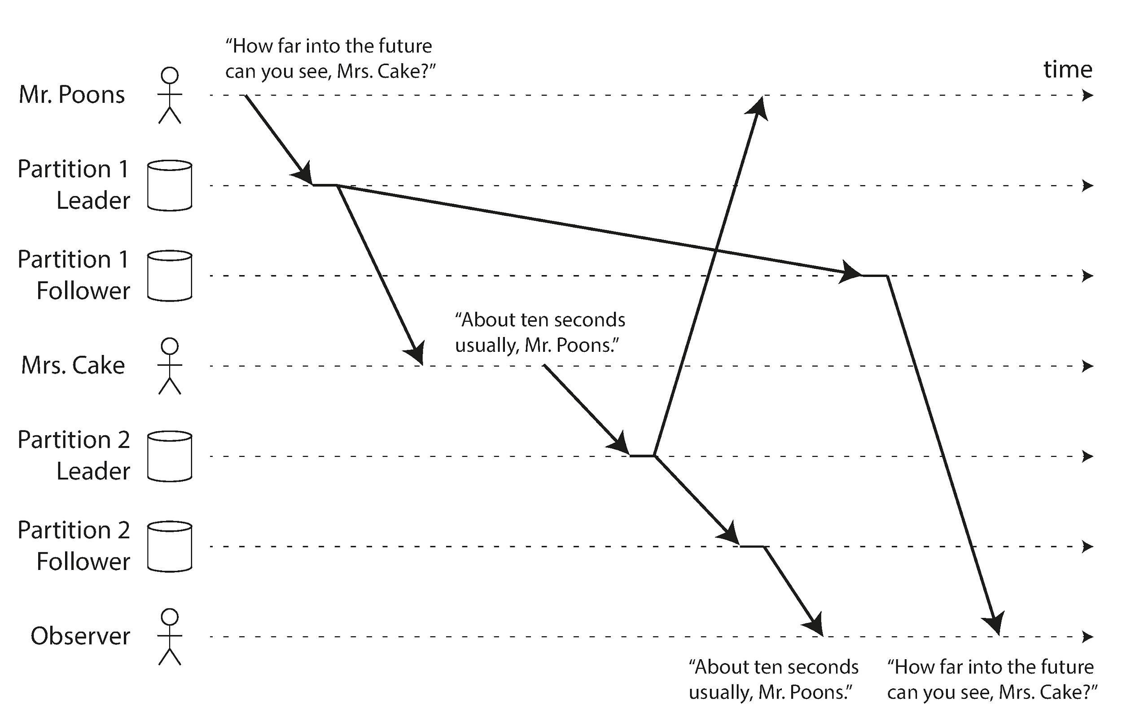
Consistent‑Prefix Reads

Slide 15
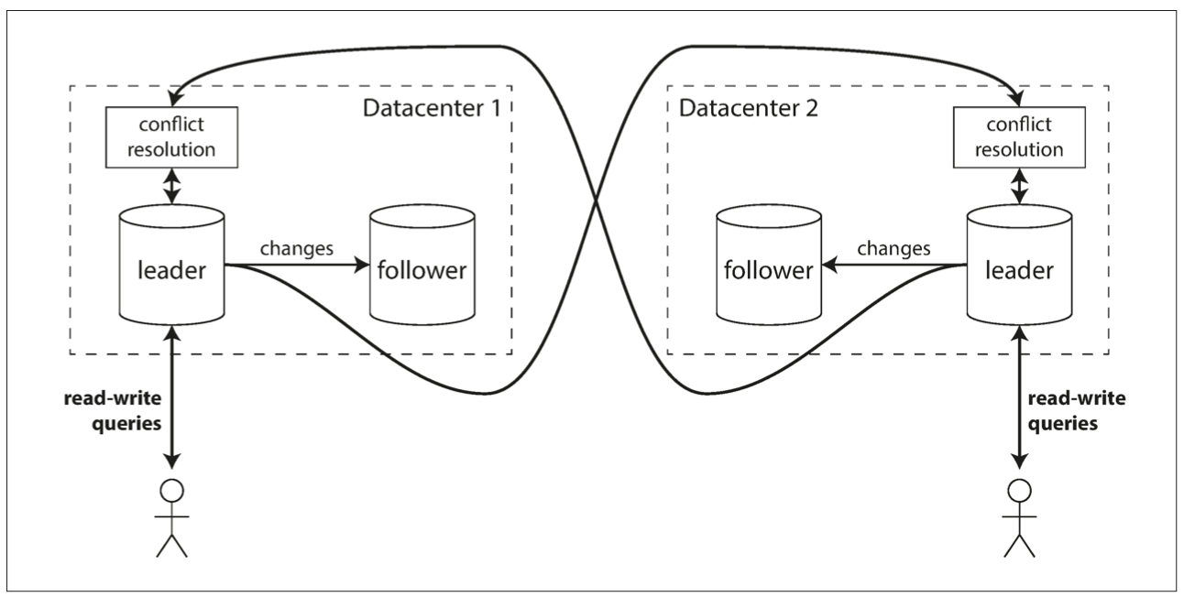
Multi‑Leader Replication – Overview
Notes:
Single‑leader systems hit their limit when clients are oceans apart or when devices must write while offline. Enter **multi‑leader replication**. Each datacenter, or each mobile device, owns a leader that can accept writes locally and ship them asynchronously to its peers.
The diagram on *page 19* (Figure 5‑6) shows two datacenters, each with an internal leader‑follower set, and cross‑datacenter replication between the leaders. Users in datacenter A write to leader A with microsecond latency; the change is later—perhaps seconds later—replayed in datacenter B.
Benefits are clear: your app keeps working during a trans‑Pacific cable cut, and deployments remain isolated. The trade‑off is the need to resolve concurrent edits that occur in different places. Autoincrement primary keys, triggers, and constraints often break in surprising ways, which is why operators regard multi‑master MySQL or Postgres BDR as a last resort rather than a first choice.

Slide 16
Multi‑Leader Replication – Overview
Allow writes on several leaders; each leader is a follower to others
Shines in multi‑datacenter and offline‑first use‑cases
Pros: local latency, continued writes during DC outage
Cons: write conflicts, subtle config pitfalls, split‑brain risks

Slide 17
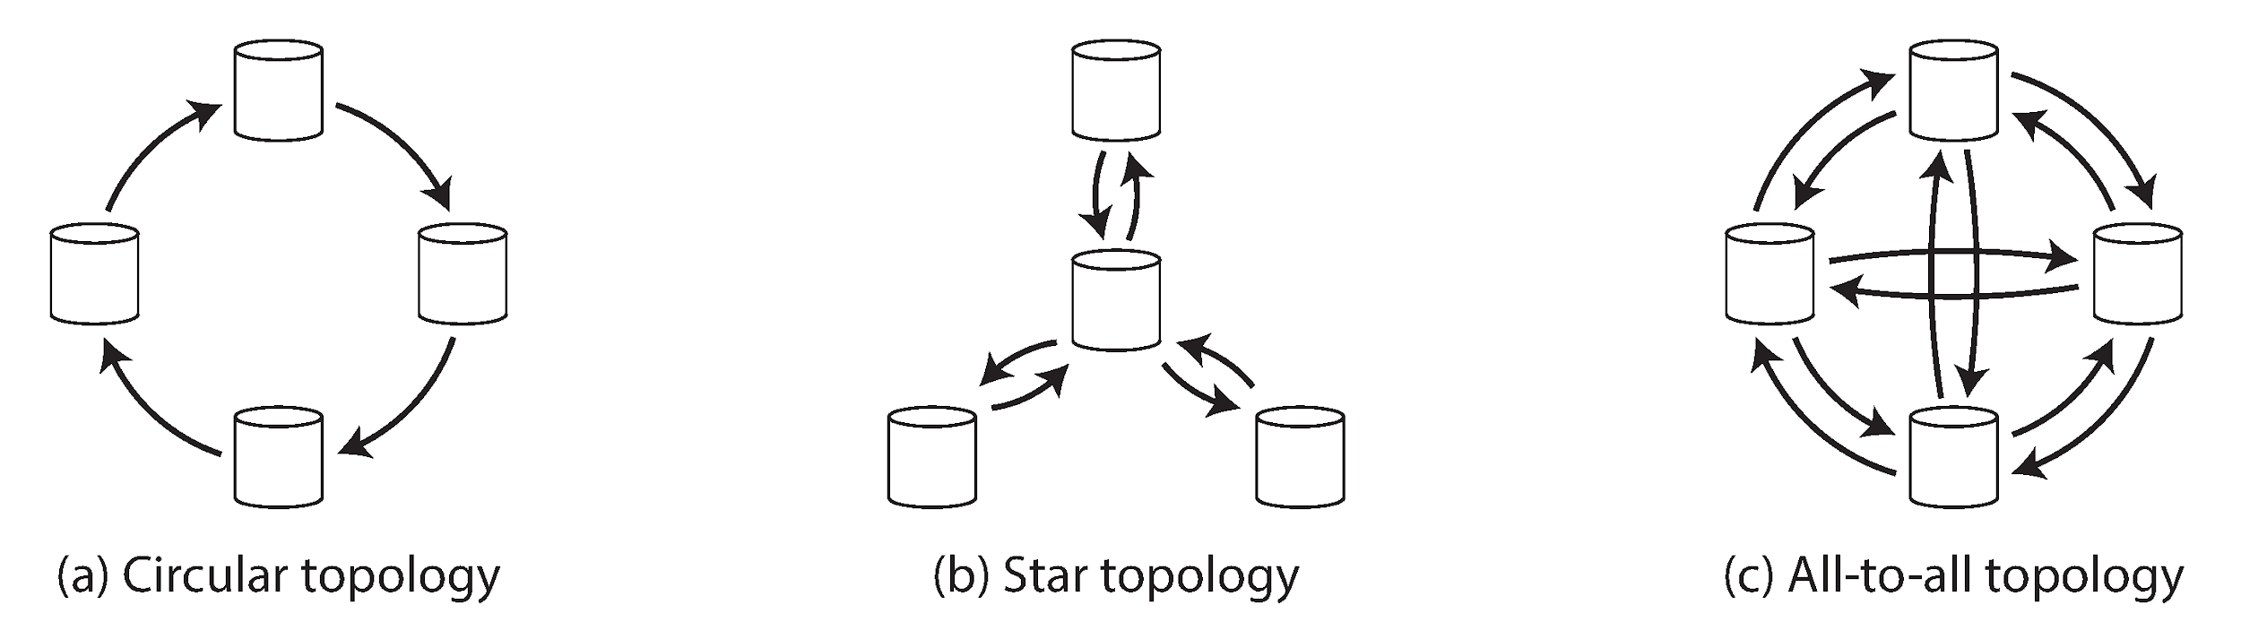
Multi‑Leader Topologies
Notes:
Topology helps manage complexity of multi‑leader systems. In a *circular* ring each node streams to one neighbour; simple, but the ring breaks if any link fails. A *star* centralises replication through a root; easier to reason about yet makes that root a choke point. An *all‑to‑all mesh* maximises redundancy but increases bandwidth usage and, paradoxically, can hurt consistency.
Figure 5‑8 sketches these options, while Figure 5‑9 shows a nasty side‑effect in dense meshes: message *re‑ordering*. If the “INSERT row” travels via a fast path and the corresponding “UPDATE row” takes a slow path, a downstream replica may apply the update before the insert, observing a primary‑key that does not yet exist. Version vectors—more on those later—are a common antidote.
When you evaluate a multi‑leader product, draw the data‑flow! The default topology may not match your failure model or bandwidth budget.

Slide 18
Multi‑Leader Topologies
Common shapes (Fig 5‑8):
• Circular chain
• Star / tree
• All‑to‑all mesh
Topology affects latency, failure tolerance, conflict frequency
Writes forwarded along path; tags prevent infinite loops
Dense mesh tolerates node loss but risks overtaking writes (Fig 5‑9)

Slide 19
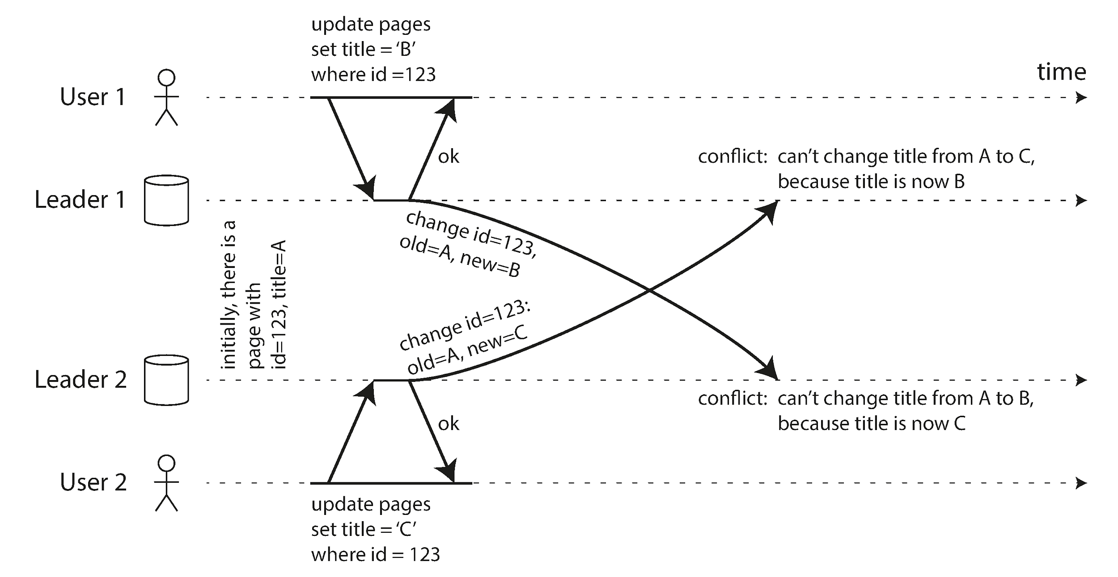
Write Conflicts in Multi‑Leader
Notes:
Figure 5‑7 illustrates the nightmare scenario: two users simultaneously rename a wiki page, one to *B*, one to *C*, each on a different leader. Both writes succeed locally; only later, when the logs converge, does the system realise the clash.
You could make conflict detection synchronous—wait for every leader to confirm before committing—but that defeats the purpose of local‑latency writes. Hence detection is asynchronous and your software must pick a policy:
• **Avoid conflicts** by routing all writes for a given record to the same leader (a fancy way of saying ‘don’t use multi‑leader if you don’t need it’).
• Resolve on **write** with server‑side code that picks a winner or merges. Bucardo lets you write Perl snippets; Oracle GoldenGate runs PL/SQL or Java.
• Resolve on **read** by surfacing multiple versions to the application or user. CouchDB famously returns JSON documents with a `_conflicts` field.
• Reach for **CRDTs** or Operational Transformation which merge automatically, but only when your data model maps neatly onto those structures.
Beware the attractive nuisance called **Last‑Write‑Wins**. It seems easy—order versions by timestamp and keep the latest—but any clock skew or network delay will silently drop valid updates.

Slide 20
Write Conflicts in Multi‑Leader
Concurrent writes to same record create conflicts (Fig 5‑7)
Sync detection ⇒ kills latency benefit; therefore detection is async
Strategies: • Conflict avoidance via record‑sharding • Custom resolution at write or read time • Automatic CRDT/OT merge
LWW is dangerous → silent data loss

Slide 21
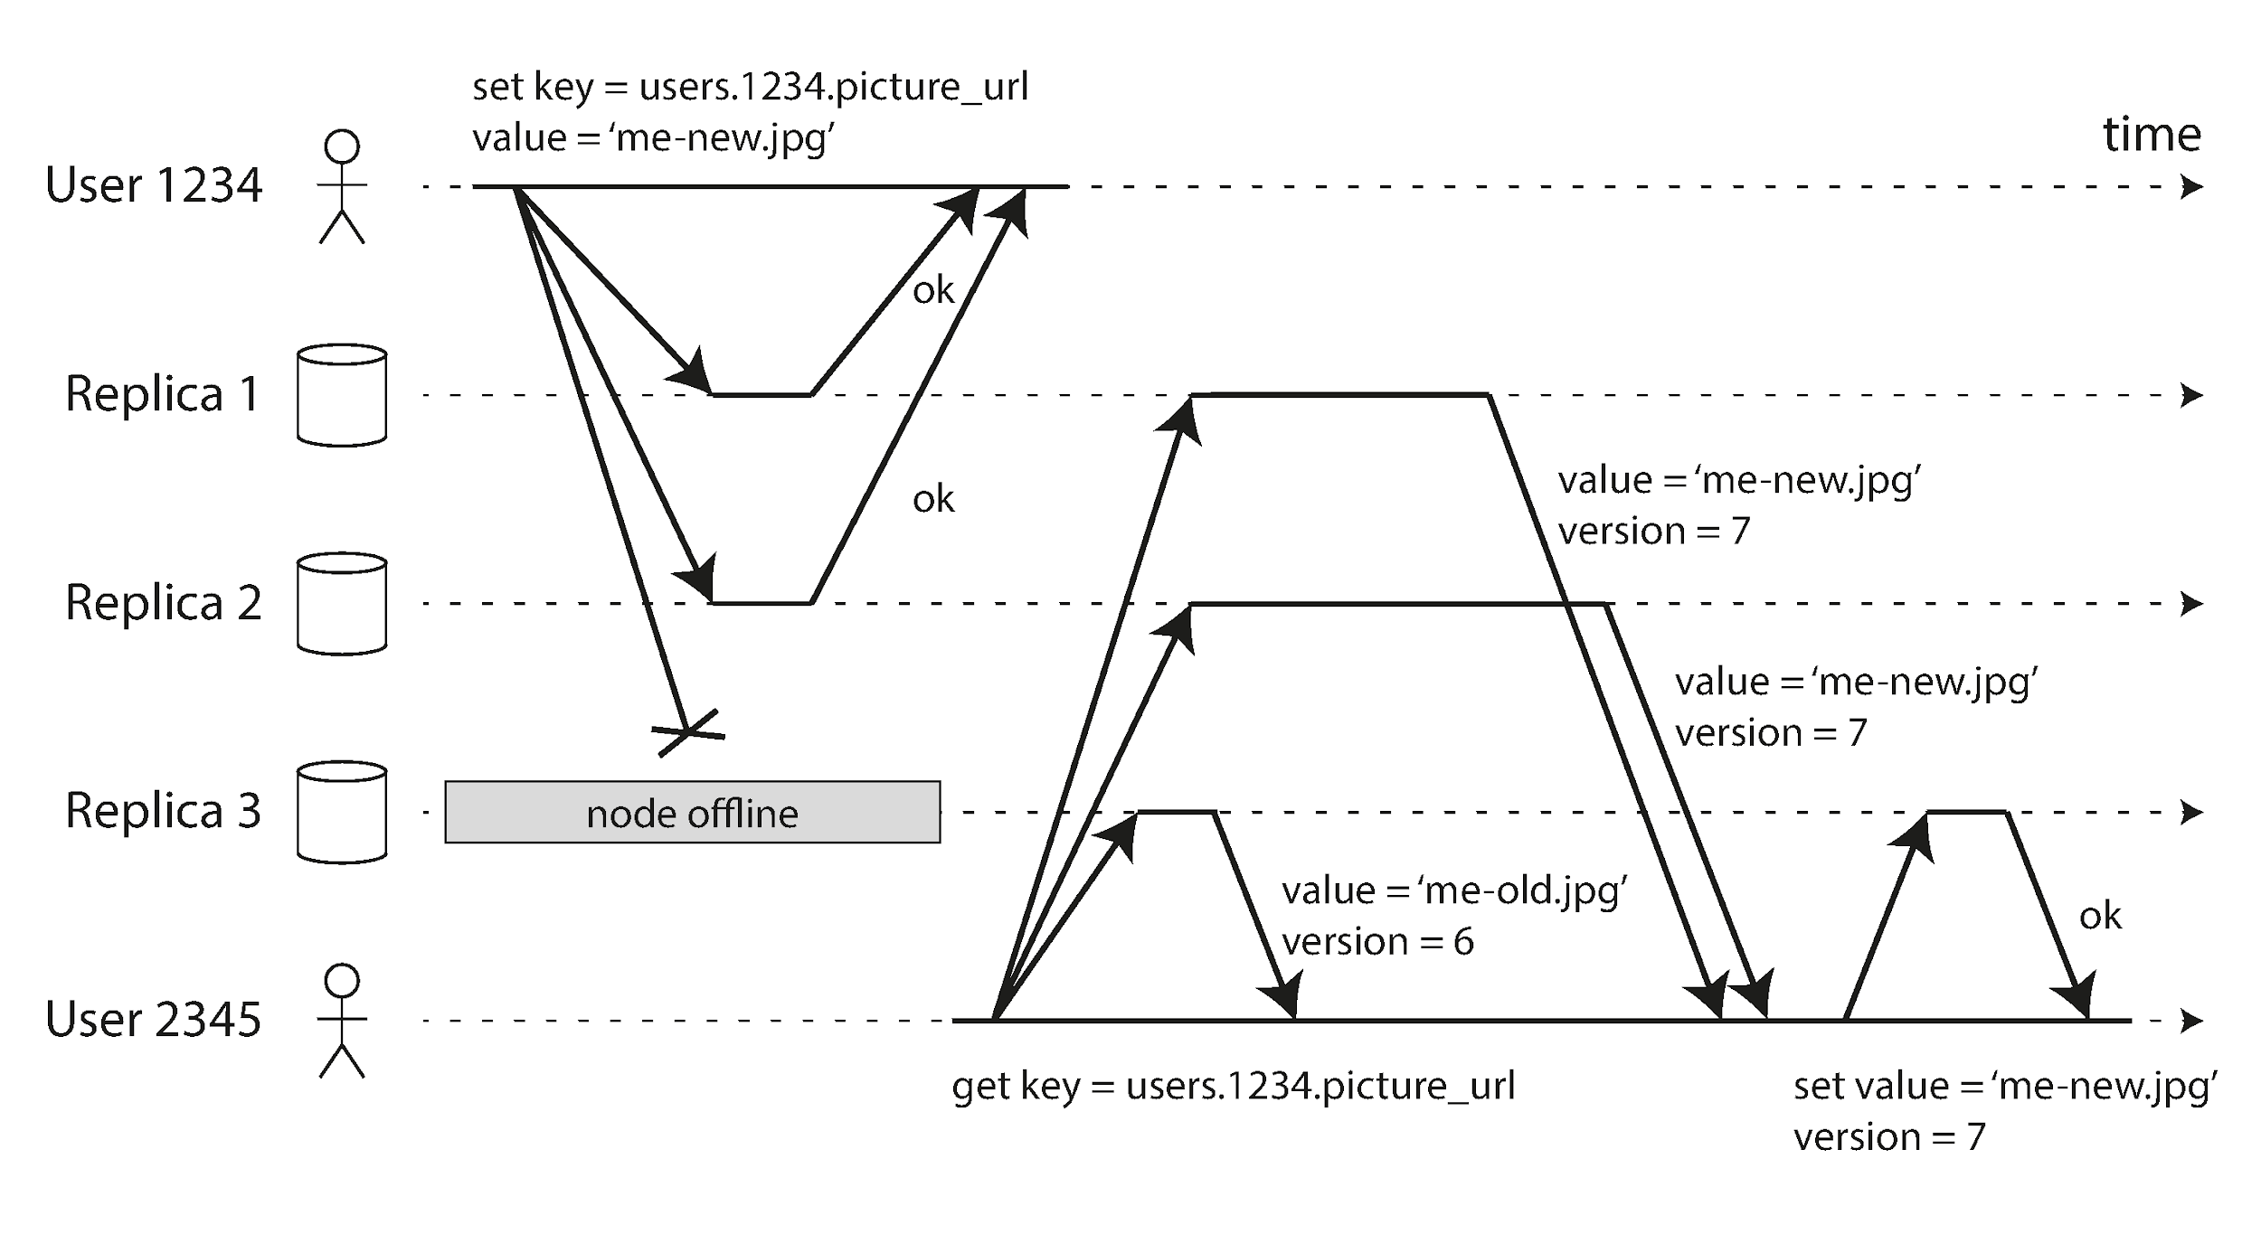
Leaderless Replication – Quorums
Notes:
Leaderless systems such as Dynamo, Cassandra, Riak, and Voldemort push the coordination logic to the *client* (or a lightweight coordinator). Each value is stored on **N** nodes — commonly three or five. A **write** is deemed successful once **W** nodes respond; a **read** queries **R** nodes and picks the latest value.
Figures 5‑10 and 5‑11 visualise this quorum principle. With N = 3, W = 2, R = 2, any single node can fail and we still have overlap between the write set and the read set, guaranteeing that at least one of the R replicas holds the latest value.
Because no special node is needed, you never trigger failover. If a coordinator dies you simply choose another. The price is probabilistic staleness: under certain races you may still read an old value, and you must handle divergent versions.

Slide 22
Leaderless Replication – Quorums
Dynamo‑style: client writes to any N replicas, succeeds after W acks
Client reads R replicas in parallel → returns newest version
Requirement W + R > N ⇒ sets of replicas overlap (Fig 5‑10/11)
Benefits: high write availability, no failover needed

Slide 23
Quorum Maths & Trade‑offs
Tuning: smaller W or R → lower latency but more stale reads
Larger N improves durability but raises resource cost
Strict quorum vs sloppy quorum + hinted handoff
Edge cases still exist: concurrent writes, replica restore, clock skew
Notes:
Quorum formulas look neat on a whiteboard, yet real clusters are messy. Operators often run with N = 5, W = 3, R = 3, tolerating two node failures; read‑heavy workloads sometimes prefer W = N, R = 1 for one‑hop reads.
**Sloppy quorums** further raise availability: if the true home nodes for a key are unreachable the coordinator writes to *other* nodes and records a ‘hint’. When connectivity returns, a background **hinted handoff** task copies the data to the correct homes. Great for keeping the system up during a rack outage, but it breaks the W + R > N overlap guarantee — meaning fresh writes may be invisible until handoff completes.
Finally, quorums do not fix every hazard: concurrent writes still produce siblings; restoring a replica from an old backup can drop W below the threshold; and if you implement LWW the whole model quietly reverts to “last writer wins” with its attendant lossiness.

Slide 24
Concurrent Writes & Siblings
Multiple versions (siblings) stored when writes arrive concurrently (Fig 5‑12)
Clients must merge values or risk lost updates
Common merge: union sets, maintain tombstones for deletes
Automatic resolution via CRDTs increasingly common
Notes:
Figure 5‑12 demonstrates two clients writing to the same key at nearly the same moment. Because replicas receive the updates in different orders they *cannot* deterministically decide which came first. Rather than discard one, Dynamo stores **siblings** — distinct versions each tagged with metadata.
On the read path the client receives *all* siblings and is responsible for merging. For sets, the union merge strategy is typical, but deletions complicate matters: you need **tombstones** to remember that an element was intentionally removed, otherwise it will resurrect during a future union.
Modern databases embed smarter data types. Riak 2.0’s G‑Sets, OR‑Maps, and counters are CRDTs that merge without application code, and collaborative‑editing algorithms such as Operational Transformation extend the principle to character sequences.
The take‑away: leaderless replication pushes conflict resolution to the edge. Make sure your application has a plan before you pick this architecture.

Slide 25
Summary & Takeaways
Single‑leader – simple, strong ordering, but leader is bottleneck
Multi‑leader – local writes & offline sync, requires conflict handling
Leaderless – highest availability, probabilistic consistency
Choose consistency level per use‑case, measure replication lag
Replication is the first step toward distributed transactions & consensus
Notes:
We have surveyed the replication landscape from the comforting certainty of single‑leader Postgres to the wild west of leaderless Dynamo. The golden rule is: *every benefit comes with a cost*.
If your workload needs strict ordering and human‑friendly operations start with a single leader. When cross‑region latency dominates or offline editing is non‑negotiable consider multi‑leader — but invest in conflict tooling early. If you are building a always‑on, write‑heavy, partition‑tolerant service at global scale then leaderless quorum systems are compelling, provided your product tolerates eventual convergence.
Regardless of flavour, monitor the lag, rehearse failover drills, and remember that replication only moves bytes — it does not, by itself, give you transactions, unique constraints, or business invariants. Those layers come next in the stack and we will meet them in Chapters 7 through 9.

Slide 26
Questions & Discussion
What trade‑off surprised you the most?
How would your current project benefit—or suffer—from a different replication model?
Notes:
Thank you for following along! We have time for questions. Feel free to ask about any detail in the diagrams, war‑stories from real systems, or dive deeper into how these replication strategies blend with partitioning, transactions, or consensus in later chapters.
If you are on‑call tonight, ask yourself: which anomaly would page me first if our leader died right now? That thought experiment is often more enlightening than benchmarks!

